Slide 1

Extracting Structural Features for Materials Property Prediction & GNN
Presenter: Lai Wei
lw36@email.sc.edu

Slide 2
The Challenges
How can we teach a machine to understand crystal structures? They are complex, periodic, and variable in size.
A machine learning model can't look at a 3D model of a crystal and understand it. It only understands numbers arranged in vectors and matrices.
The Problem: The pymatgen Structure object is a complex, abstract representation designed for scientists.
The Solution: The feature extraction tool acts as a translator. It converts abstract concepts like "a Sodium atom bonded to a Chlorine atom" into concrete numerical data that the model can process.

Slide 3
Approach 1: Manual Feature Engineering
What is Feature Engineering?
Machine learning models understand numbers, not crystal structures. The goal of feature engineering is to translate a complex material structure into a simple numerical vector (a "fingerprint").
We start with a rich, complex object (a crystal structure from pymatgen).
We use our scientific knowledge to decide which features are important (e.g., atomic properties, bond lengths).
We calculate these features and arrange them into a fixed-length list of numbers.
This process is manual because a human scientist chooses which features to calculate.
[pymatgen Structure Object] -> [matminer Featurizer] -> [Feature Vector: (0.54, 2.1, 153.4, ...)]

Slide 4
Using matminer to Describe Crystal Structures
Matminer is a powerful open-source Python library designed for Materials Informatics.
A Toolbox for Data Mining: It provides tools for every step of the ML pipeline.
Vast Library of Featurizers: It contains over 70 pre-built featurizers to describe composition, structure, and electronic properties. We don't have to code the calculations from scratch!
Seamless Integration: Works perfectly with pymatgen for structure representation and pandas for data manipulation.
Data Access: Includes methods to easily pull data from major materials databases like the Materials Project.

Slide 5
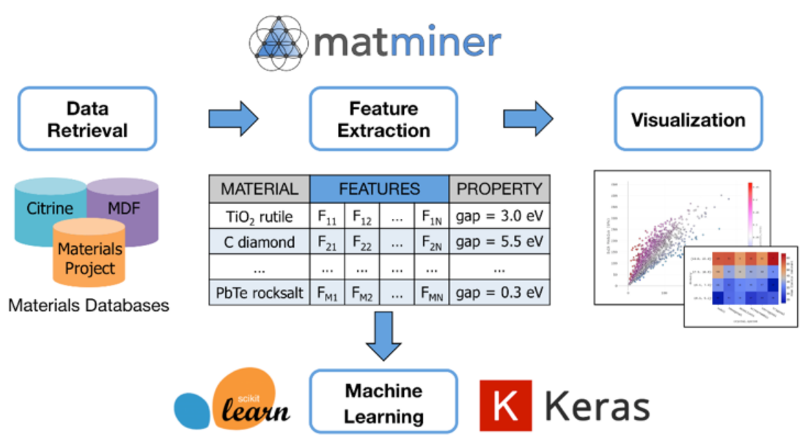
Matminer

Slide 6
matminer in Colab
See Colab code walkthrough.

Slide 7
Limitations of Manual Featurization
Time-Consuming and Labor-Intensive: Designing, coding, and testing new features requires significant time and effort from a domain expert.
Limited by Human Imagination and Bias: The model's performance is capped by the features a human thinks to provide. It cannot discover important patterns if the relevant features aren't included.
Fails to Capture Complex Interactions: It is extremely difficult to manually design features that describe subtle, multi-atom interactions or complex geometric patterns, whereas GNNs can learn these automatically.
Features are Often Not Transferable: Features that are predictive for one class of materials (e.g., oxides) may not work well for another class (e.g., intermetallics).

Slide 8
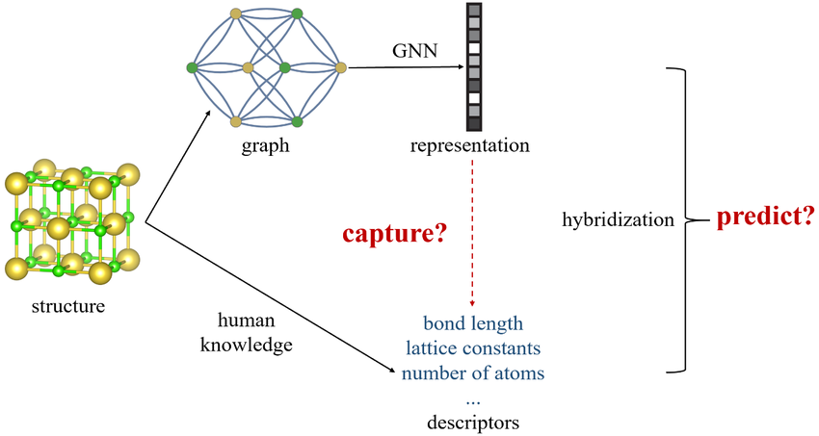
Approach 2: Automated Feature Learning with GNNs

Slide 9
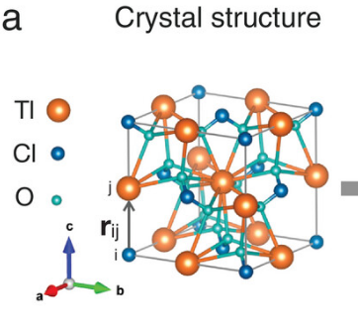
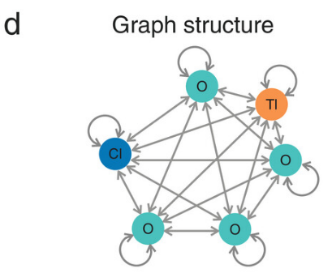
What is a Graph Neural Network (GNN)?
Graph Neural Networks (GNNs) are a class of models built to understand the complex relationships and structure within data that can be represented as a graph of nodes and edges.
A crystal structure is a perfect real-world example of a graph:
Nodes are the atoms. Each atom has its own properties (e.g., atomic number, electronegativity).
Edges are the chemical bonds connecting the atoms. Each bond has properties too (e.g., its length).

Slide 10
How It Learns from a Crystal?
Converting the structure to features is the process of encoding the fundamental rules of chemistry and physics into a format the GNN can understand and learn from.
Atoms become nodes: Each atom in the crystal is treated as a fundamental node in the network.
Atomic Properties become node features: Every atom is described by a vector of numerical features, such as its atomic number and electronegativity, that define its chemical identity.
Bonds become edges: The chemical bonds between atoms define the connections, or edges, in the network. These edges are the pathways through which atoms influence each other.

Slide 11
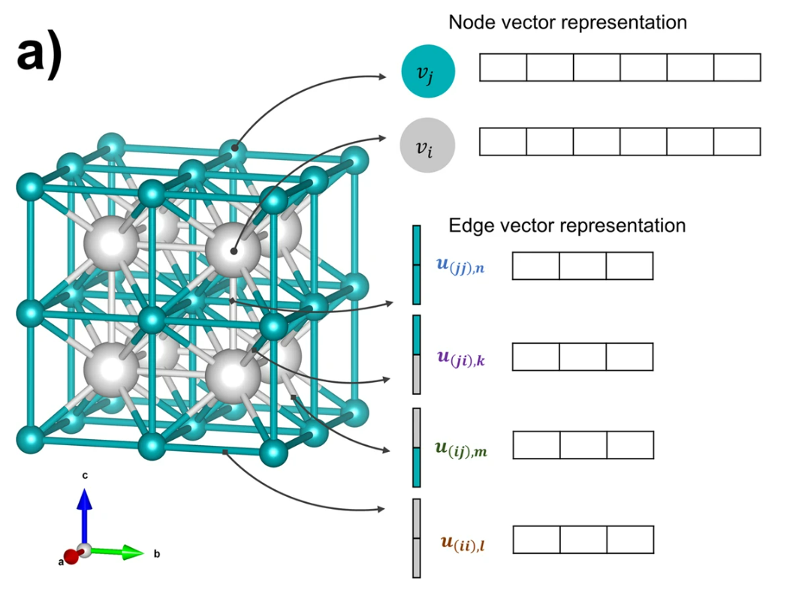
How It Learns from a Crystal?

Slide 12
How It Learns from a Crystal?
Input: The GNN takes the crystal graph as input, the atoms with their features and the bonds that connect them.
Message Passing: The GNN allows each atom (node) to "talk" to its bonded neighbors, passing information along the bonds (edges). Through this process, each atom builds up a sophisticated understanding of its local chemical environment.
Output: After several rounds of this "message passing," the GNN aggregates all the learned information to make a single prediction about the entire crystal, such as its stability, band gap.

Slide 13
Training a GNN in Colab
See Colab code walkthrough. Please note that this is a very simple example. While the results look perfect, it's crucial to understand their limitation. This model is heavily overfitting. In a real research project, the next steps would be to ensure the model can generalize to new data.
An advanced model (ALIGNN) can be found in : https://github.com/usnistgov/alignn

Slide 14
Real-word application: ALIGNN
The Atomistic Line Graph Neural Network (https://www.nature.com/articles/s41524-021-00650-1) introduces a new graph convolution layer that explicitly models both two and three body interactions in atomistic systems.
Atomisitic line graph neural network-based FF (ALIGNN-FF) (https://pubs.rsc.org/en/content/articlehtml/2023/dd/d2dd00096b) can be used to model both structurally and chemically diverse systems with any combination of 89 elements from the periodic table, specially for structural optimization. To train the ALIGNN-FF model, we have used the JARVIS-DFT dataset which contains around 75000 materials and 4 million energy-force entries, out of which 307,113 are used in the training. These models can be further finetuned, or new models can be developed from scratch on a new dataset.
GitHub link: https://github.com/usnistgov/alignn

Slide 15
THANKS!
Name: Lai Wei
Email: lw36@email.sc.edu

